Slide 1
Data Structures and Algorithms
CACS201
Unit 3:Queue
Shyam Sunder Khatiwada

Slide 2
Queue Data Structure
A Queue is defined as a linear data structure that is open at both end and the operations are performed in First in First Out (FIFO) order.
We define a queue to be a list in which all additions to the list are made at one end, and all deletions from the list are made at the other end. The element which is first pushed into the order is first performed on that.
Queue follows the First In First Out (FIFO) rule - the item that goes in first is the item that comes out first.

Slide 3
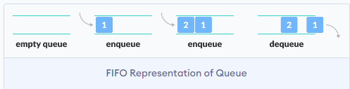
Queue Data Structure
As in figure, 1 was kept in the queue before 2, it is the first to be removed from the queue as well.
Adding the items in the queue is called enqueue, and removing the items form the queue is called dequeue.
Queue can be implemented in any programming language like C, C++, Java, Python or C#, but the specification is same in all.

Slide 4
Points: Queue Data Structure
Queue is a linear list of elements in which deletion of an element can take place at one end, called the front and insertion can take place at the other end, called the rear.
The first element in a queue will be the first one to be removed from the list.
Queues are also called FIFO (First in First Out).
The process to add an element into queue is called Enqueue and the process of removal of an element from the queue is called Dequeue.

Slide 5
Basic Operations of Queue: Queue as an ADT
A queue is an object (an abstract data structure- ADT) that allows the following operations:
Enqueue - Add an element to the end of the queue.
Dequeue - Remove an element from the front of the queue.
IsEmpty - Check if the queue is empty.
IsFull - Check if the queue is full.
Peek - Get the value of the front of the queue without removing it.

Slide 6
Implementation of Linear Queue:
There are two techniques for implementing the queue:
Array implementation of queue (Static memory allocation)
Linear array implementation (Linear Queue)
Circular array implementation (Circular queue)
Linked list implementation of queue (dynamic memory allocation)

Slide 7
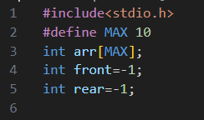
Working of Queue:
Queue operations work as follows:
Two pointers FRONT and REAR
FRONT → track the first element of the queue
REAR → track the last element of the queue
Initially, set value of FRONT and REAR to -1.
Array of size n to store the items.

Slide 8
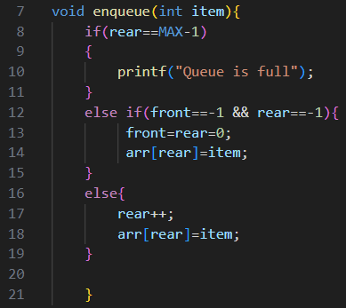
Enqueue Operation
Algorithm:
Step 1: check if the queue is full
Step 2: for the first element, set the value of FRONT to 0
Step 3: increase the REAR index by 1
Step 4: add the new element in the position pointed to by REAR

Slide 9
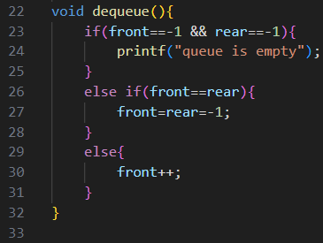
Dequeue Operation:
Algorithm:
Step 1: check if the queue is empty
Step 2: return the value pointed by FRONT
Step 3: increase the FRONT index by 1
Step 4: for the last element, reset the values of Front and REAR to -1.

Slide 10
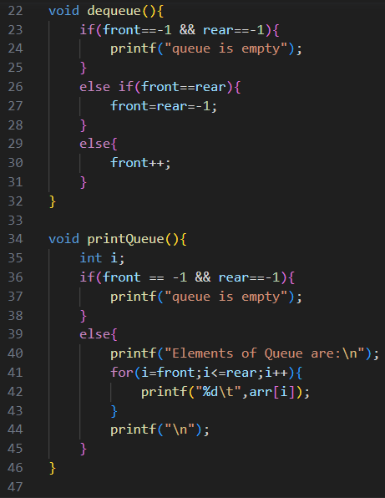
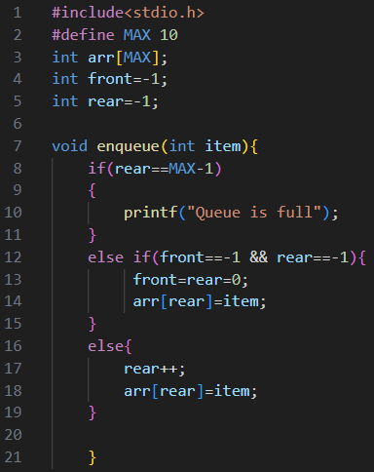
Implementation of Linear Queue:

Slide 11
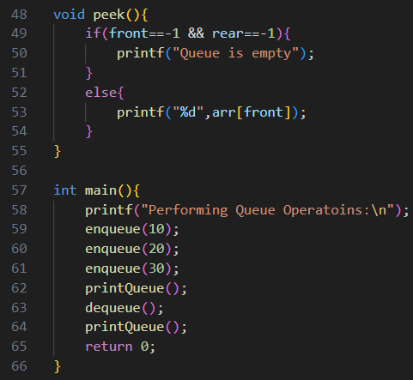

Implementation of Linear Queue:
Output:

Slide 12
GitHub Link: Implementation of Queue
Implementation of Queue: using array: Click Here

Slide 13
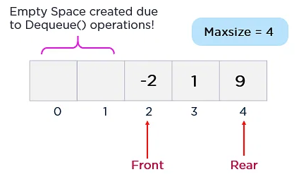
Drawbacks of Linear Queue:
Both rear and front indices are increased but never decreased.
As items are removed from the queue, the storage space at the beginning of the array is discarded and never used again.
Wastage of the space is the main problem with linar queue which is illustrated by the following example.

Slide 14
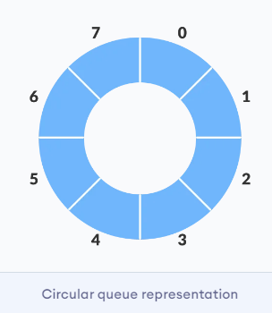
Circular Queue:
A circular queue is an extended version of a linear queue as it follows the First in First Out principle with the exception that it connects the last node of a queue to its first by forming a circular link.
It is also called a Ring Buffer.
It solves the major drawback of the linear queue. In normal queue, after a bit of insertion and deletion, there will be non-usable empty space.

Slide 15
Points: Circular Queue
A queue where the start and end the queue are joined together.
A circular queue overcomes the problem of unutilized space in linear queue implementation as array.
A circular queue is one in which the insertion of a new elements is done at very first location of the queue if the last location of the queue is full.
It is also called “Ring Buffer”

Slide 16
Operations on Circular Queue:
Front- get the front item front the queue.
Rear - get the last item from the queue.
enqueue - insert an element into the circular queue.
check whether the queue is full (i.e., the rear end is in just before the front end in a circular manner)
if it is full then display queue is full.
if the queue is not full, then insert an element at the end of queue.
dequeue - delete an element from the circular queue.
check whether the queue is empty.
If it is empty then display Queue is empty.
If the queue is not empty, then get the last element and remove it from the queue.

Slide 17
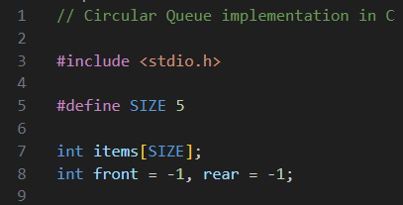
Working of Circular Queue:
The circular queue work as follows:
Two pointers FRONT and REAR
FRONT - track the first element of the queue.
REAR - track the last element of the queue.
initially, set value of FRONT and REAR to -1.
an array of size n.

Slide 18
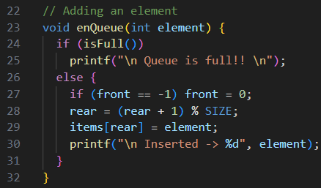
Enqueue Operation:
Algorithm:
Step 1: check if the queue is full.
Step 2: for the first element, set value of FRONT to 0.
Step 3: Circularly increase the REAR index by 1 ( if the rear reaches the end, next it would be at the start of the queue)
Step 4: add the new element in the position pointed to by REAR.

Slide 19
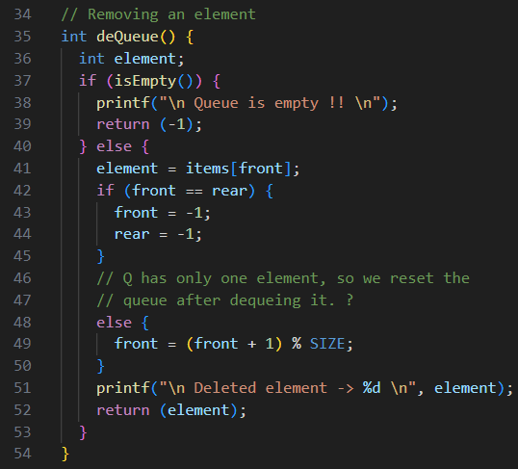
Dequeue Operation:
Algorithm:
Step 1: check if the queue is empty.
Step 2: return the value pointed by FRONT.
Step 3: circulatory increase the FRONT index by 1.
Step 4: for the last element, reset the values of FRONT and REAR to -1.

Slide 20
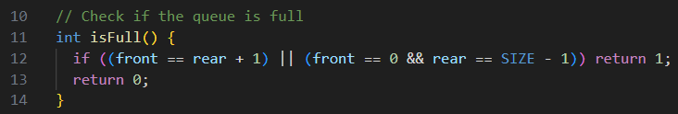
Additional case while checking circular queue is full:
Case 1: FRONT ==0 && REAR==MAX-1
Case 2: FRONT=REAR +1
The second case happens when REAR starts from 0 due to circular increment and when its value is just 1 less than FRONT, the queue is full.

Slide 21
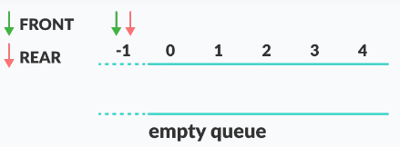
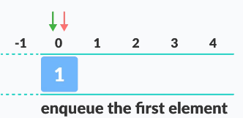
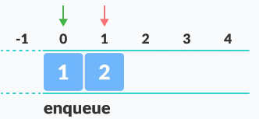
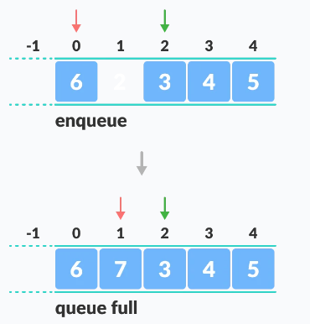
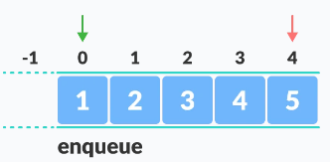
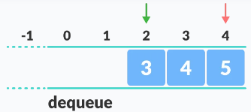
Example:

Slide 22
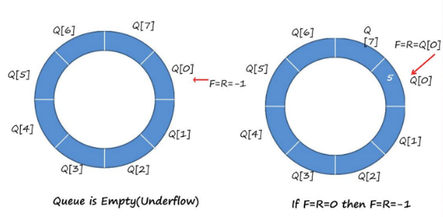
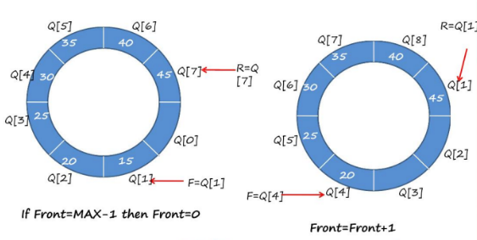
Example

Slide 23
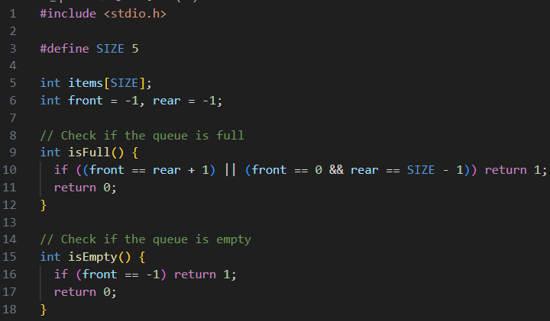
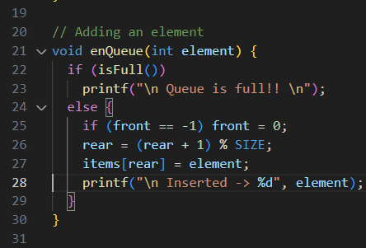
Code: Circular Queue implementation

Slide 24

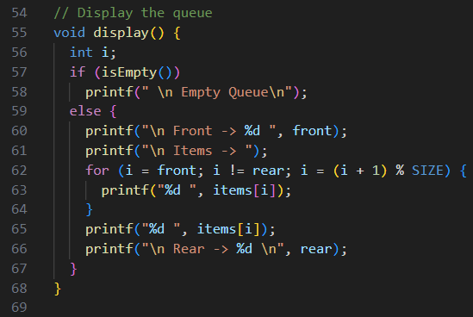
Code: Circular Queue implementation

Slide 25
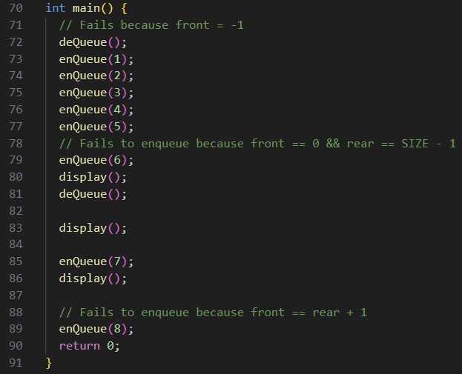
Code: Circular Queue implementation

Slide 26
Workout:
Q1:List out the difference between the Linear queue and Circular queue.

Slide 27
Queue Applications:
Some of the real world applications of queues are
Cashier line in any store/
People in an escalator.
Check in and check out at any book store.
Some of the application of queue related to computer science are:
Data getting transferred between the IO Buffers (Input Output Buffers).
CPU scheduling and Disk scheduling.
Managing shared resources between various process.
Managing shared resources between various process.
Job scheduling algorithms.
Round robin scheduling.
Recognizing a palindrome.

Slide 28
Priority Queue:
A priority queue is a special type of queue in which each element is associated with a priority value.
Elements are served on the basis of their priority.
Elements having high priority are served first.
However, if elements with the same priority occur, they are served according to their order in the queue.

Slide 29
Assigning priority value:
The element with the highest value is considered the highest priority element.
However, in other cases, we can assume the element with the lowest value as the highest priority element.
We can also set priorities according to our needs.

Slide 30
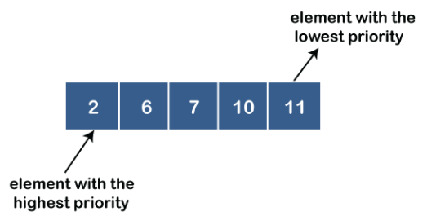
Types of Priority Queue:
Ascending Priority Queue
In this type of priority queue, elements can be inserted into any order but only the smallest element can be removed.
In ascending order priority queue, a lower priority number is given as a higher priority in a priority.

Slide 31
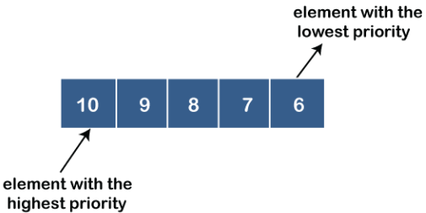
Types of Priority Queue:
2. Descending Priority Queue:
In this type of priority queue, elements can be inserted into any order but only the largest element can be removed.
In descending order priority queue, a higher priority number is given as a higher priority in a priority+6

Slide 32
Operations : Priority Queue
Enqueue: Adds an element with its associated priority to the priority queue. The element is placed in a position according to its priority, maintaining the order of priorities.
Dequeue: Removes and returns the element with the highest priority from the priority queue.
Peek (or Top): Returns the element with the highest priority without removing it from the priority queue.
IsEmpty: Checks if the priority queue is empty.
IsFull: Checks if the priority queue is full (if it has a fixed size).

Slide 33
Any Query?
Thank You!!

